Slide 1
Database Management System (CS403)
VU
Lecture No. 31
Reading Material
Raghu Ramakrishnan, Johannes Management Systems’, Second edition
Gehkre,
‘Database
Chapter 17
Overview of Lecture
Types of Joins
Relational Calculus
Normalization
In the previous lecture we studied that rows from two tables can be merged with each other using the Cartesian product. In real life, we very rarely find a situation when two tables need to be merged the way Cartesian product, that is, every row of one table is merged with every row of the other table. The form of merging that is useful and used most often is ‘join’. In the following, we are going to discuss different forms of join.
Inner Join
Only those rows from two tables are joined that have same value in the common
attribute. For example, if we have two tables R and S with schemes
R (a, b, c, d) and S (f, r, h, a), then we have ‘a’ as common attribute between these twit tables. The inner join between these two tables can be performed on the basis of ‘a’ which is the common attribute between the two. The common attributes are not required to have the same name in both tables, however, they must have the same domain in both tables. The attributes in both tables are generally tied in a primary- foreign key relationship but that also is not required. Consider the following two tables:

Slide 2
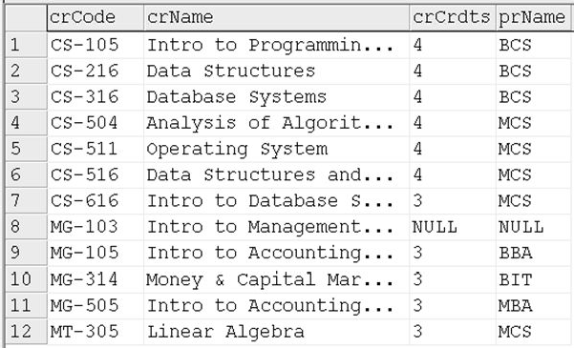
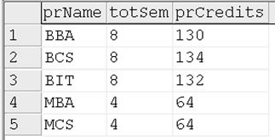
Database Management System (CS403)
VU
Fig. 1: COURSE and PROGRAM tables with common attribute prName
The figure shows two tables, COURSE and PROGRAM. The COURSE.prName and PROGRAM. prName are the common attributes between the two tables; incidentally the attributes have the same names and definitely the same domains. If we apply inner join on these tables, the rows from both tables will be merged based on the values of common attribute, that is, the prName. Like, row one of COURSE has the value ‘BCS’ in attribute prName. On the other hand, row number 2 in PROGRAM table has the value ‘BCS’. So these two rows will merge and form one row of the resultant table of the inner join operation. As has been said before, the participating tables of inner join are generally tied in a primary-foreign key link, so the common attribute is PK in one of the tables. It means the table in which the common attribute is FK, the rows from this table will not be merged with more that one row from the other table. Like in the above example, each row from COURSE table will find exactly one match in PROGRAM table, since the prName is the PK in PROGRAM table.
The inner join can be implemented using different techniques. One possibility is that we may find ‘inner join’ operation as such, like:

Slide 3
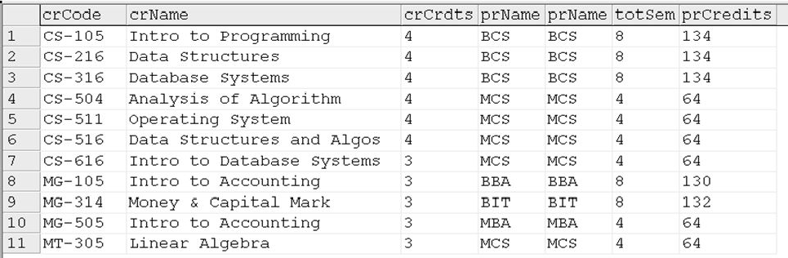
Database Management System (CS403)
VU
SELECT * FROM course INNER JOIN program ON course.prName = program.prName
or
Select * FROM Course c INNER JOIN program p ON c.prName = p.prName
The output after applying inner join on tables of figure 1 will be as follows:
Fig. 2: Output of inner join on tables of figure 1
As can be seen in the figure, the common attribute appears twice in the output of inner
join; that is, from both the tables. Another possible approach to implement inner join can be as follows:
SELECT * FROM course, program WHERE course.prName = program.prName
The output of this statement will be exactly the same as is given in figure 2.
Outer Join
SQL supports some interesting variants of the join operation that rely on null values,
called outer joins. Consider the two tables COURSE and PROGRAM given in figure 1 and their inner join given in figure 2. Tuples of COURSE that do not match some row in PROGRAM according to the inner join condition (COURSE.prName = PROGRAM.prName) do not appear in the result. In an outer join, on the other hand, COURSE rows without a matching PROGRAM row appear exactly once in the result, with the result columns inherited from PROGRAM assigned null values.

Slide 4
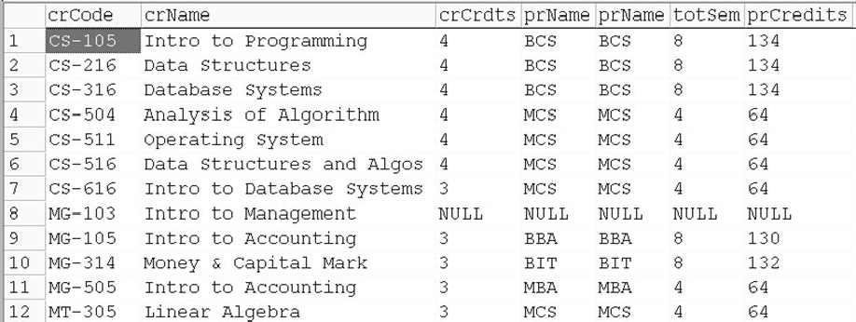
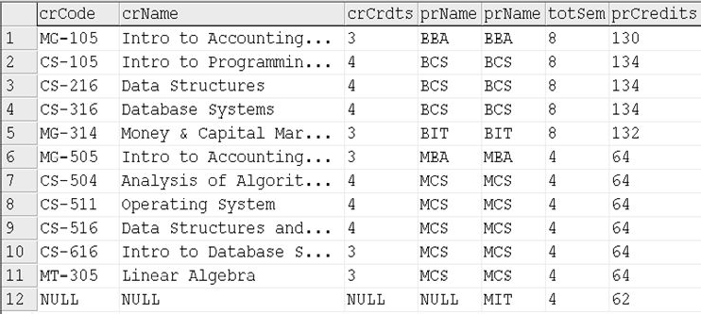
Database Management System (CS403)
VU
In fact, there are several variants of the outer join idea. In a right outer join, COURSE rows without a matching PROGRAM row appear in the result, but not vice versa. In a
left outer join, PROGRAM rows without a matching COURSE row appear in the result, but not vice versa. In a full outer join, both COURSE and PROGRAM rows without a match appear in the result. (Of course, rows with a match always appear in the result, for all these variants, just like the usual joins or inner joins).
SQL-92 allows the desired type of join to be specified in the FROM clause. For example,
Select * from COURSE c RIGHT OUTER JOIN
PROGRAM p on c.prName = p.prName
Fig. 3: Right outer join of the tables in figure 1
In figure 3 above, the row number 8 is the non matching row of COURSE that
contains nulls in the attributes corresponding to PROGRAM table, rest of the rows are the same as in inner join of figure 2.
Select * from COURSE c LEFT OUTER JOIN
PROGRAM p on c.prName = p.prName

Slide 5
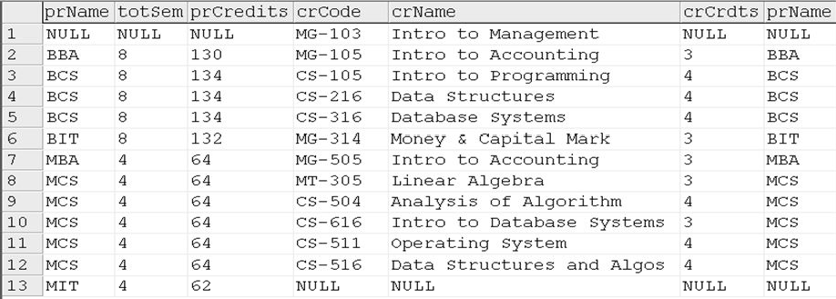
Database Management System (CS403)
VU
Fig. 4: Left outer join of the tables in figure 1
In figure 4 above, the row number 12 is the non matching row of PROGRAM that contains nulls in the attributes corresponding to COURSE table, rest of the rows are the same as in inner join of figure 2.
Select * from COURSE c FULL OUTER JOIN
PROGRAM p on c.prName = p.prName
Fig. 5: Full outer join of the tables in figure 1
In figure 5 above, the row number 1 and 13 are the non matching rows from both tables, rest of the rows are the same as in inner join of figure 2.
Semi Join
Another form of join that involves two operations. First inner join is performed on the
participating tables and then resulting table is projected on the attributes of one table. The advantage of this operation is that we can know the particular rows of one table that are involved in inner join. For example, through semi join of COURSE and
PROGRAM tables we will get the rows of COURSE that have matching rows in PROGRAM, or in other words, the courses that are part of any program. Same can be performed other way round. SQL does not provide any operator as such, but can be implemented by select and inner join operations, for example.
SELECT distinct p.prName, totsem, prCredits FROM program p inner JOIN course c ON p.prName = c.prName

Slide 6
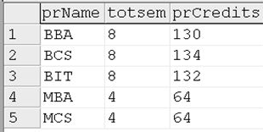
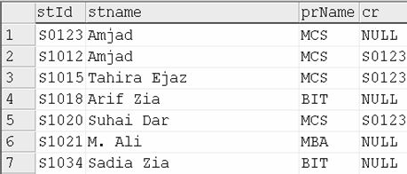
Database Management System (CS403)
VU
Fig. 6: Semi join of tables in figure 1
Self Join
In self join a table is joined with itself. This operation is used when a table contains
the reference of itself through PK, that is, the PK and the FK are both contained in the
same table supported by the referential integrity constraint. For example, consider STUDENT table having an attribute ‘cr’ storing the id of the student who is the class representative of a particular class. The example table is shown in figure 7, where a CR has been specified for the MCS class, rest of the class students contain a null in the ‘cr’ attribute.
Fig. 7: Example STUDENT table Applying self join on this table:

Slide 7
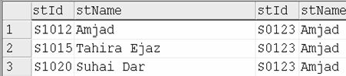
Database Management System (CS403)
VU
SELECTa.stId, a.stName, b.stId, b.stName FROM student a, student b WHERE a.cr = b.stId
Since same table is involved two times in the join, we have to use the alias. The above statement displays the names of the students and of the CR.
Fig. 8: Self join of STUDENT table of figure 7
Subquery
Subquery is also called nested query and is one of the most powerful features of SQL.
A nested query is a query that has another query embedded within it; the embedded
query is called a subquery. When writing a query, we sometimes need to express a condition that refers to a table that must itself be computed. The query used to compute this subsidiary table is a subquery and appears as part of the main query. A subquery typically appears within the WHERE clause of a query. Subqueries can sometimes appear in the FROM clause or the HAVING clause. Here we have discussed only subqueries that appear in the WHERE clause. The treatment of subqueries appearing elsewhere is quite similar. Examples of subqueries that appear in the FROM clause are discussed in following section.
Lets suppose we want to get the data of the student with the maximum cgpa, we cannot get them within a same query since to get the maximum cgpa we have to apply the group function and with group function we cannot list the individual attributes. So we use nested query here, the outer query displays the attributes with the condition on cgpa whereas the subquery finds the maximum cgpa as shown below:
SELECT * from student where cgpa >
(select max(cgpa) from student where prName = 'BCS‘)

Slide 8
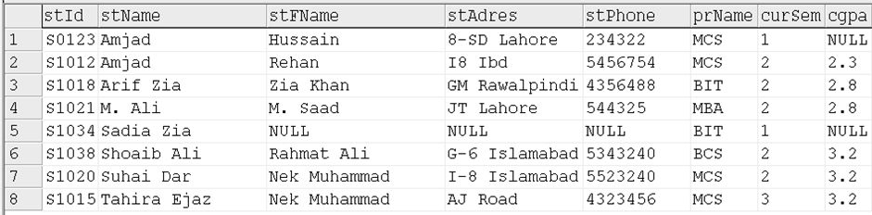
Database Management System (CS403)
VU
Fig. 9: STUDENT table and nested query applied on it
We have to take care of the operator being applied in case of subquery in the where clause. The type of operator depends on the result set being returned by the subquery. If the output expected from the subquery is a single value, as is the case in the above example, then we can use operators like =, <, >, etc. However, if the subquery returns multiple values then we can use operators like IN, LIKE etc. The IN operator allows us to test whether a value is in a given set of elements; an SQL query is used to generate the set to be tested. We can also use the NOT IN operator where required.
The subquery can be nested to any level, the queries are evaluated in the reverse order, and that is, the inner most is evaluated first, then the outer one and finally the outer most.
ACCESS CONTROL
SQL-92 supports access control through the GRANT and REVOKE commands. The
GRANT command gives users privileges to base tables and views. The syntax of this command is as follows:
GRANT privileges ON object TO users [ WITH GRANT OPTION ]
For our purposes object is either a base table or a view. Several privileges can be specified, including these:
SELECT: The right to access (read) all columns of the table specified as the object, including columns added later through ALTER TABLE commands.
INSERT(column-name): The right to insert rows with (non-null or nondefault) values in the named column of the table named as object. If this right is to be granted with

Slide 9
Database Management System (CS403)
VU
respect to all columns, including columns that might be added later, we can simply use INSERT. The privileges UPDATE(column-name) and UPDATE are similar.
DELETE: The right to delete rows from the table named as object. REFERENCES(column-name): The right to define foreign keys (in other tables) that refer to the speci_ed column of the table object. REFERENCES without a column name speci_ed denotes this right with respect to all columns, including any that are added later.
If a user has a privilege with the grant option, he or she can pass it to another user
(with or without the grant option) by using the GRANT command. A user who creates a base table automatically has all applicable privileges on it, along with the right to grant these privileges to other users. A user who creates a view has precisely those privileges on the view that he or she has on every one of the view or base tables used to define the view. The user creating the view must have the SELECT privilege on each underlying table, of course, and so is always granted the SELECT privilege on the view. The creator of the view has the SELECT privilege with the grant option only if he or she has the SELECT privilege with the grant option on every underlying table.
In addition, if the view is updatable and the user holds INSERT, DELETE, or
UPDATE privileges (with or without the grant option) on the (single) underlying table, the user automatically gets the same privileges on the view.
Only the owner of a schema can execute the data definition statements CREATE, ALTER, and DROP on that schema. The right to execute these statements cannot be granted or revoked.
In conjunction with the GRANT and REVOKE commands, views are an important component of the security mechanisms provided by a relational DBMS. We will discuss the views later in detail. Suppose that user Javed has created the tables COURSE, PROGRAM and STUDENT. Some examples of the GRANT command that Javed can now execute are listed below:
GRANT INSERT, DELETE ON COURSE TO Puppoo WITH GRANT OPTION
GRANT SELECT ON COURSE TO Mina
GRANT SELECT ON PROGRAM TO Mina WITH GRANT OPTION

Slide 10
Database Management System (CS403)
VU
There is a complementary command to GRANT that allows the withdrawal of privileges. The syntax of the REVOKE command is as follows:
REVOKE [GRANT OPTION FOR] privileges ON object FROM users
{RESTRICT | CASCADE}
The command can be used to revoke either a privilege or just the grant option on a privilege (by using the optional GRANT OPTION FOR clause). One of the two alternatives, RESTRICT or CASCADE, must be specified; we will see what this choice means shortly. The intuition behind the GRANT command is clear: The creator of a base table or a view is given all the appropriate privileges with respect to it and is allowed to pass these privileges including the right to pass along a privilege to other users. The REVOKE command is, as expected, intended to achieve the reverse: A user who has granted a privilege to another user may change his mind and want to withdraw the granted privilege. The intuition behind exactly what effect a REVOKE command has is complicated by the fact that a user may be granted the same privilege multiple times, possibly by different users.
When a user executes a REVOKE command with the CASCADE keyword, the effect is to withdraw the named privileges or grant option from all users who currently hold these privileges solely through a GRANT command that was previously executed by the same user who is now executing the REVOKE command. If these users received the privileges with the grant option and passed it along, those recipients will also lose their privileges as a consequence of the REVOKE command unless they also received these privileges independently. Consider what happens after the following sequence of commands, where Javed is the creator of COURSE.
GRANT SELECT ON COURSE TO Alia WITH GRANT OPTION (executed by
Javed)
GRANT SELECT ON COURSE TO Bobby WITH GRANT OPTION (executed by Alia)
REVOKE SELECT ON COURSSE FROM Alia CASCADE (executed by Javed)
Alia loses the SELECT privilege on COURSE, of course. Then Bobby, who received this privilege from Alia, and only Alia, also loses this privilege. Bobby's privilege is said to be abandoned when the privilege that it was derived from (Alia's SELECT privilege with grant option, in this example) is revoked. When the CASCADE

Slide 11
Database Management System (CS403)
VU
keyword is specified, all abandoned privileges are also revoked (possibly causing privileges held by other users to become abandoned and thereby revoked recursively). If the RESTRICT keyword is specified in the REVOKE command, the command is rejected if revoking the privileges just from the users specified in the command would result in other privileges becoming abandoned.
Consider the following sequence, as another example:
GRANT SELECT ON COURSE TO Alia WITH GRANT OPTION (executed by Javed)
GRANT SELECT ON COURSE TO Bobby WITH GRANT OPTION (executed by Javed)
GRANT SELECT ON COURSE TO Bobby WITH GRANT OPTION (executed by Alia)
REVOKE SELECT ON COURSE FROM Alia CASCADE (executed by Javed)
As before, Alia loses the SELECT privilege on COURSE. But what about Bobby?
Bobby received this privilege from Alia, but he also received it independently (coincidentally, directly from Javed). Thus Bobby retains this privilege. Consider a third example:
GRANT SELECT ON COURSE TO Alia WITH GRANT OPTION (executed by Javed)
GRANT SELECT ON COURSE TO Alia WITH GRANT OPTION (executed by Javed)
REVOKE SELECT ON COURSE FROM Alia CASCADE (executed by Javed)
Since Javed granted the privilege to Alia twice and only revoked it once, does Alia get to keep the privilege? As per the SQL-92 standard, no. Even if Javed absentmindedly granted the same privilege to Alia several times, he can revoke it with a single REVOKE command. It is possible to revoke just the grant option on a privilege: GRANT SELECT ON COURSE TO Alia WITH GRANT OPTION (executed by Javed) REVOKE GRANT OPTION FOR SELECT ON COURSE FROM Alia CASCADE (executed by
Javed)
This command would leave Alia with the SELECT privilege on COURSE, but Alia no longer has the grant option on this privilege and therefore cannot pass it on to other
users.
Summary
In this lecture we have studied the different types of joins, with the help of which we
can join different tables. We also discussed two major commands of access control
that are also considered the part of Data Control Language component of SQL. The last part of this lecture handout is taken from chapter 17 of the reference given. The

Slide 12
Database Management System (CS403)
VU
interested users are recommended to see the book for detailed discussion on the topic. There is a lot left on SQL, for our course purposes however we have studied enough.
Through extensive practice you will have clear understanding that will help you in further learning.
Exercise:
Practice for all various types of Joins and Grant and Revoke commands.

Slide 13
Database Management System (CS403)
VU
Lecture No. 32
Reading Material
“Database Management Systems”, 2nd edition, Raghu Ramakrishnan, Johannes Gehrke, McGraw-Hill
Database Management, Jeffery A Hoffer
Overview of Lecture
Application Programs
User Interface
Designing Forms
Until now we have studied conceptual database design, whose goal is to analyze the application and do a conceptual design on the application. The goal is to provide a conceptual design and description of reality. It is independent of data model. Then we discussed the relational database design. A relational database stores all its data inside tables, and nothing more. All operations on data are done on the tables themselves or produce another tables as the result. Here we had discussed the selection of data model. Thereafter we had discussed data manipulation language through SQL. We are using SQL Server as a tool. In this lecture we will discuss application program.
Application Programs
Programs written to perform different requirement posed by the users/organization are the application programs. Application programs can be developed in parallel or after the construction of database design. Tool selection is also critical, but it depends upon developer in which he feels comfortable.
General Activities in Application Programs
Following are the general activities, which are performed during the development of application programs:
Data input programmes
Editing
Display

Slide 14
Database Management System (CS403)
VU
Processing related to activities
Reports
User Interface
In the minds of users, a system's user interface is the system; everything else is just stuff they're happy to ignore. The design of the user interface is therefore critical to the success or failure of a project. Get it right, and your users will forgive the occasional infelicity in implementation. Get it wrong, and it won't really matter how efficient your code is.
The irony here is that if you do get it right, hardly anyone will notice. Really elegant interfaces are invisible. Even if you get it wrong, no one might notice. The interfaces of many computer systems, particularly database systems, are so awkward that your system will be just one more of the mediocre, mildly abusive computer systems people have come to expect.
Effective interfaces can also require more work to implement, although this isn't necessarily the case. In addition, the payoffs can be huge, and they're not all of the "virtue is its own reward" variety. An effective user interface minimizes the time users require to learn and implement the system. Once the system is implemented, productivity gains are higher if users don't have to struggle to bend it to their will. Chances are good that both of these issues were addressed in the project goals. They certainly impact the infamous bottom line.
Effective interfaces that closely match the users' expectations and work processes also minimize the need for external documentation, which is always expensive. And while users might not consciously notice how wonderful your user interface is, they'll certainly notice that your system seems to just work better.
So, what constitutes an effective interface? To my mind, it's one that helps users accomplish their tasks and otherwise gets out of the way. An effective interface doesn't impose its requirements on users. It never forces users to play by its rules; it plays by the users' rules. An effective interface doesn't force users to learn a bunch of

Slide 15
Database Management System (CS403)
VU
uninteresting stuff just to use it. And finally, it doesn't behave in unexpected ways. Following are the two types of user interfaces:
Text based
Graphical User Interface (GUI) most commonly called as Forms
Text Based User Interface
In text based user interface certain keyboard numbers are designated for any action but it is used very rarely nowadays. For example
Adding a Record Deleting a Record Enrollment
Result Calculation Exit
1
2
3
4
5
Forms
Forms are now days used extensively in the application programs. Following are the different types of forms

Slide 16
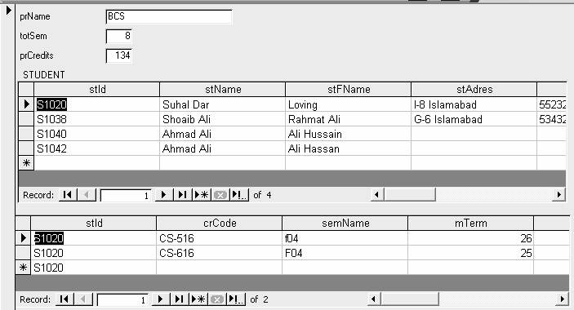
Database Management System (CS403)
VU
Browser Based
These are web-based forms. They are developed in HTML, scripting language or
Front Page.
Non-Browser/Simple
Graphical User Interface
This is an example of Graphical user interface
User Friendly Interfaces
Two definitions of user-friendly that are often mooted are "easy to learn" and "easy to use." If we put aside for the moment the question of what, exactly, "easy" means, we still have to ask ourselves, "Easy for whom?" The system that's easy for a beginner to learn is not necessarily easy for an expert to use. Your best approach is to consider the needs of each level of user and accommodate each with different facets of the interface. Following are the different kinds of users:
Beginners
Everyone is a beginner at some point. Very few people remain that way—they will either pass through the stage to intermediacy, or they'll discard your system entirely in favor of someone else's. For this reason, you must be careful not to build in support for beginners that will get in the way of more advanced users. Beginners need to know what your system does before they start to learn how to use it. The best way to present this information is outside the main system itself. For simple systems, an introductory dialog box that describes the system can be sufficient. (Just be sure you always include a means of dismissing the dialog box permanently.) For more complex

Slide 17
Database Management System (CS403)
VU
systems, a guided tour might be more appropriate. Online help isn't a good option for beginners. They might not know it exists or, if they do, how to use it. I have had some
success using an online user's guide, however, by including a link to it from the introductory dialog box and from the Help menu. To be successful with beginners, these guides must be task-oriented. Beginners don't want to know what "menu item" means; they want to know how to create an invoice.
Intermediate
For most systems, the majority of users fall into the intermediate category. Intermediate users know what the system does, but they often forget the details of how. This is the group you must support directly in the user interface. Fortunately, the Microsoft Windows interface provides a lot of tools for helping these users.A well- designed menu system is one of the best tools for reminding intermediate users of the system capabilities. A quick scan of the available menu items will immediately remind them of the functions available and at the same time allow them to initiate the appropriate task.
An excellent second level of support for intermediate users is online help. Writing online help is outside the scope of this book. In this context, however, I will mention that most intermediate users will use the index as their primary access mechanism. The index should therefore be as complete as you can possibly make it.
Experts
Expert users know what to do and how to do it. They're primarily interested in doing things quickly. The more shortcuts you can build into your system, the happier you will make this group of users. In my experience, expert users tend to be keyboard- oriented, so make sure that you provide a way to move around the system using the keyboard if you're catering to this group.Expert users also appreciate the ability to customize their working environment. Providing this functionality can be an expensive exercise, however, so you will want to carefully evaluate the benefit before including it. If you do decide to include some level of interface customization, even if it's only a matter of arranging windows on the screen, be certain to maintain the changes between sessions. Nothing is as irritating as having to rearrange everything every time you load a program

Slide 18
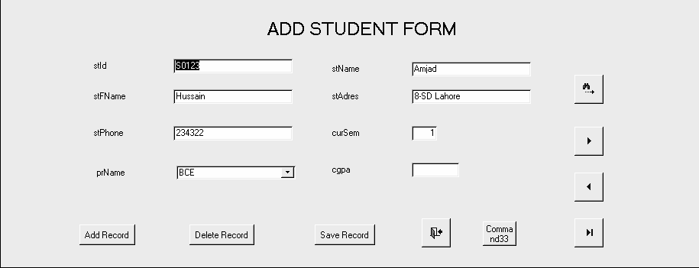
Database Management System (CS403)
VU
Tips for User Friendly Interface
Following are some of the important tips, which should be adhered for interfaces:
It should be user friendly and user must not search for required buttons or text boxes.
Interface should be designed in such a manner that user is in charge of the form.
It should be designed in manner that user memory is always tested
You should be consistent in your approach while designing interface.
It should be processes based rather than the data structure based.
Entities and Relationships
First type is the simple entity on a page.

Slide 19
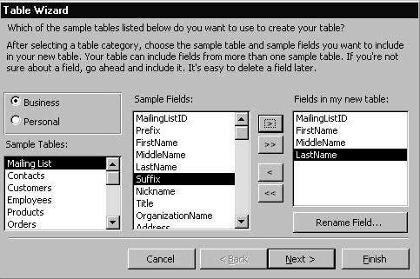
Database Management System (CS403)
VU
Windows Controls
There are number of controls which are used to take input and display output like buttons, checkboxes etc. Following are the examples

Slide 20
Database Management System (CS403)
VU
Numbers, Dates and Text
Normally text boxes are used for the display of dates
Summary
In today’s lecture we have studied the application programs and designing user interface and forms. We have studied different techniques and practices for the user interface and form designing. We will discuss an example of form designing in our next lecture.

Slide 21
Database Management System (CS403)
VU
Lecture No. 33
Reading Material
Programming Microsoft Access Mastering MS Access
Overview of Lecture
Designing Input Form
Arranging Form
Adding Command Buttons
In the previous lecture we have discussed the importance of user interface. It plays an important role in the development of any application. User will take interest in the application if user interface is friendly. We then discussed different tools, which are used in the development of any application. In this lecture we will see the designing of input forms.
An input form is an easy, effective, efficient way to enter data into a table. Input forms are especially useful when the person entering the data is not familiar with the inner workings of Microsoft Access and needs to have a guide in order to input data accurately into the appropriate fields. Microsoft Access provides several predefined forms and provides a forms wizard that walks you through the process of creating a form. One of these predefined forms will be used in the example below. You can also create your own customized forms by using Microsoft Access form design tools. Following things must be ensured for input forms:
Forms should be user friendly
Data integrity must be ensured, which means that database must represent the true picture of real system.
Checks can be applied within the tables definition or through input forms

Slide 22
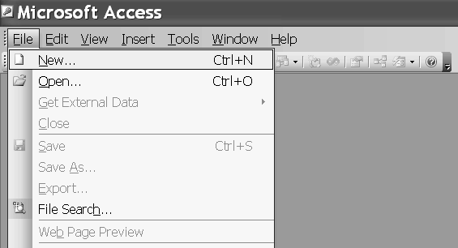
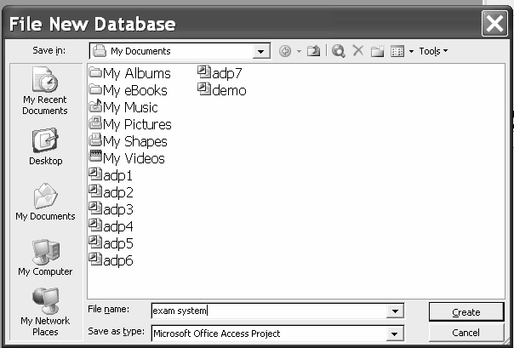
Database Management System (CS403)
VU
So first we will run MS Access and select New option from the file. Next it will ask the name of database as follows.
We have given the name as Exam System, we will then press the create button and following screen would be available.

Slide 23
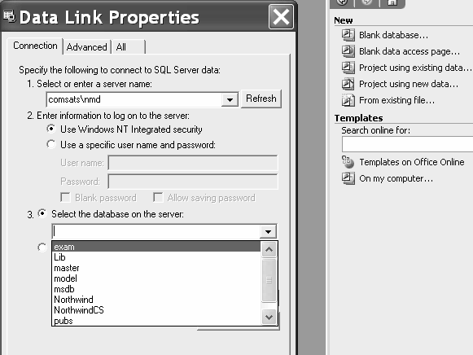
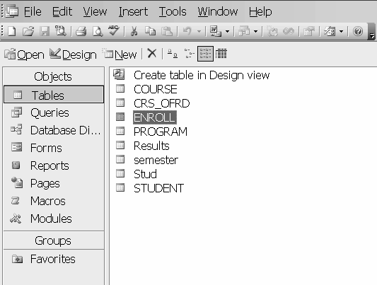
Database Management System (CS403)
VU
In this screen we will first select project using existing data from New templates, as we are using data of SQL Server that is why we are using this option. Next move on to Data Link Properties dialog, which is adjacent one. So first select the connection
Tab in which first select the server name then is the security setting after selecting that option then is the selection of database on which forms are to be constructed.
Now these are the tables of Exam Data base, with which connectivity has been established. Now we will select the Forms option as under:

Slide 24
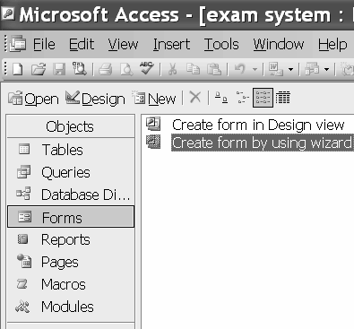
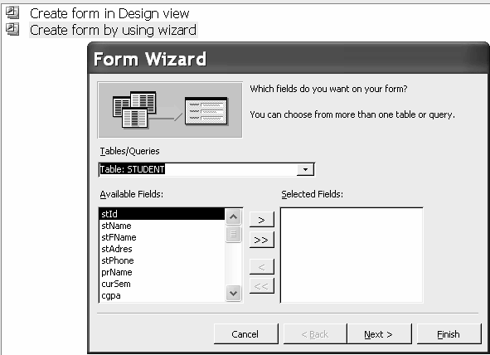
Database Management System (CS403)
VU
So here are two options in design and wizard both we are selecting wizard view after selecting this next screen would be as under:
Now here we will select the concerned table and initially we are selecting single table that is of STUDENT. Next is the selection of required attributes for the concerned
table as under.

Slide 25
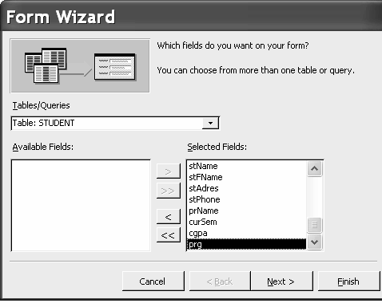
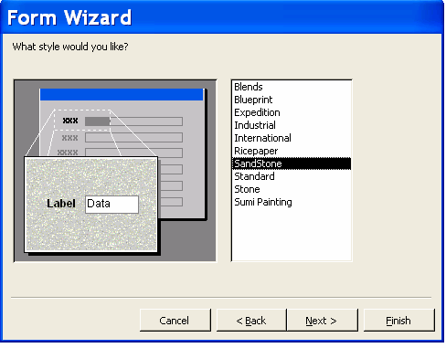
Database Management System (CS403)
VU
Then is the selection of required layout for the form. There are different options available in this option. We can select the required option. We have selected Column option for the layout of forms. Then is the selection of background or style for our forms as under. We have selected the SandStone option.

Slide 26
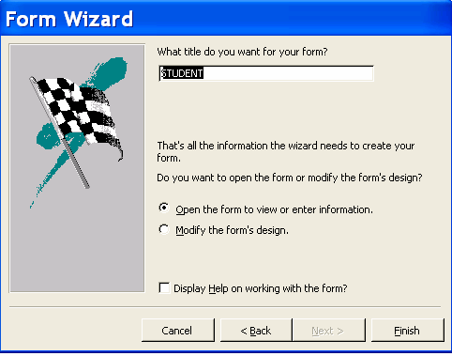
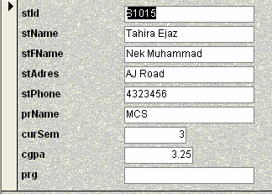
Database Management System (CS403)
VU
Next is the selection of title for the form as under.
Next is the form view as under in which we can view our data.

Slide 27
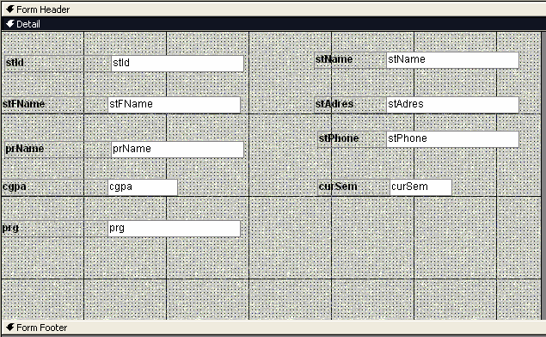
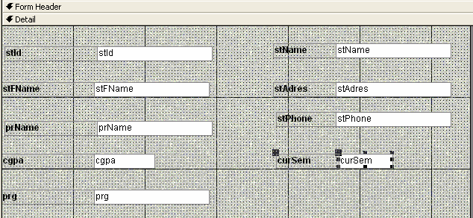
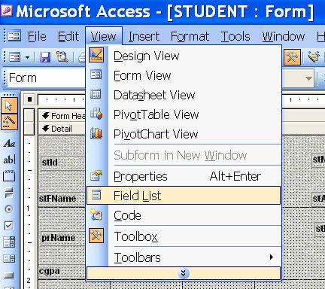
Database Management System (CS403)
VU
Forms must be designed and arranged in a systematic manner now
Next is deleting a field from the form.
If we want to add an attribute in the list.
n this example, a command button beside each record is used to open another form.
I

Slide 28
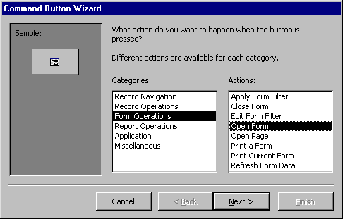
Database Management System (CS403)
VU
Open the form in Design View and ensure that the Control Wizard button on the toolbox is pressed in.
Click the command button icon on the toolbox and draw the button on the form. The Command Button Wizard will then appear.
On the first dialog window, action categories are displayed in the left list while the right list displays the actions in each category. Select an action for the command button and click Next .
The next few pages of options will vary based on the action you selected. Continue selecting options for the command button.
Choose the appearance of the button by entering caption text or selecting a picture. Check the Show All Pictures box to view the full list of available

Slide 29
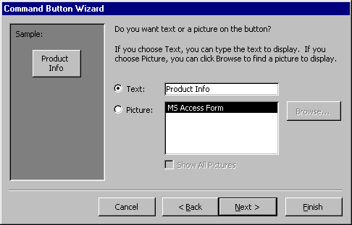
Database Management System (CS403)
VU
images.
Click
Next
>.
Enter a name for the command button and click Finish to create the button.
In today’s lecture we have studied the designing of forms. Forms are used as an alternative way to enter data into a database table. It can be made more perfect with lots of practice and designing number of forms. So it needs practice. We have designed a simple form through wizard. A more complex form can also be designed with some practice.

Slide 30
Database Management System (CS403)
VU
Lecture No. 34
Reading Material
“Database Management Systems”, 2nd edition, Raghu Ramakrishnan, Johannes Gehrke, McGraw-Hill
“Modern Database Benjamin/Cummings | Management”, | Fred | McFadden, | Jeffrey | Hoffer,
Overview of Lecture
Data Storage Concepts
Physical Storage Media
Memory Hierarchy
In the previous lecture we have discussed the forms and their designing. From this lecture we will discuss the storage media.
Classification of Physical Storage MediaStorage media are classified according to
following characteristics: Speed of access
Cost per unit of data
Reliability
We can also differentiate storage as either Volatile storage
Non-volatile storage
Computer storage that is lost when the power is turned off is called as volatile storage. Computer storage that is not lost when the power is turned off is called as non –
volatile storage, pronounced cashe is a special high-speed storage mechanism. It can
be either a reserved section of main memory or an independent high-speed sto- rage device. Two types of caching are commonly used in personal computers: memory caching and disk caching.
A memory cache, sometimes called a cache store or RAM. Cache is a portion of memory made of high-speed static RAM (SRAM) instead of the slower and cheaper DRAM used for main memory. Memory caching is effective because most programs access the same data or instructions over and over. By keeping as much of this information as possible in SRAM, the computer avoids accessing the slower DRAM. Some memory caches are built into the architecture of microprocessors.. The Intel 80486 microprocessor, for example, contains an 8K memory cache, and the Pentium has a 16K cache. Such internal caches are often called Level 1 (L1) caches. Most modern PCs also come with external cache memory, called Level 2 (L2) caches. These caches sit between the CPU and the DRAM. Like L1 caches, L2 caches are composed of SRAM but they are much larger. Disk caching works under the same principle as memory caching, but instead of using high-speed SRAM, a disk cache
k (as
uses conventional main memory. The most recently accessed data from the dis
© Copyright Virtual University of Pakistan

Slide 31
Database Management System (CS403)
VU
well as adjacent sectors) is stored in a memory buffer. When a program needs to
access data from the disk, it first checks the disk cache to see if the data is there. Disk caching can dramatically improve the performance of applications, because accessing a byte of data in RAM can be thousands of times faster than accessing a byte on a hard disk.
When data is found in the cache, it is called a cache hit, and the effectiveness of a cache is judged by its hit rate. Many cache systems use a technique known as smart
caching, in which the system can recognize certain types of frequently used data. The
strategies for determining which information should be kept in the cache constitute some of the more interesting problems in computer science.
The main memory of the computer is also known as RAM, standing for Random
Access Memory. It is constructed from integrated circuits and needs to have electrical power in order to maintain its information. When power is lost, the information is lost too! The CPU can directly access it. The access time to read or write any particular byte are independent of whereabouts in the memory that byte is, and currently is approximately 50 nanoseconds (a thousand millionth of a second). This is broadly comparable with the speed at which the CPU will need to access data. Main memory is expensive compared to external memory so it has limited capacity. The capacity available for a given price is increasing all the time. For example many home Personal Computers now have a capacity of 16 megabytes (million bytes), while 64 megabytes is commonplace on commercial workstations. The CPU will normally transfer data to and from the main memory in groups of two, four or eight bytes, even if the operation it is undertaking only requires a single byte.
Flash memory is a form of EEPROM that allows multiple memory locations to be erased or written in one programming operation. Normal EEPROM only allows one
location at a time to be erased or written, meaning that flash can operate at higher effective speeds when the system uses it to read and write to different locations at the same time. All types of flash memory and EEPROM wear out after a certain number of erase operations, due to wear on the insulating oxide layer around the charge
storage mechanism used to store data.
Flash memory is non-volatile, which means that it stores information on a silicon chip in a way that does not need power to maintain the information in the chip. This means that if you turn off the power to the chip, the information is retained without consuming any power. In addition, flash offers fast read access times and solid-state shock resistance. These characteristics are why flash is popular for applications such as storage on battery-powered devices like cellular phones and PDAs.Flash memory is based on the Floating-Gate Avalanche-Injection Metal Oxide Semiconductor (FAMOS transistor) which is essentially an NMOS transistor with an additional conductor suspended between the gate and source/drain terminals.
Magnetic disk is round plate on which data can be encoded. There are two basic types of disks: magnetic disks and optical disks on magnetic disks, data is encoded as microscopic magnetized needles on the disk's surface. You can record and erase data on a magnetic disk any number of times, just as you can with a cassette tape. Magnetic disks come in a number of different forms:
Floppy Disk: A typical 5¼-inch floppy disk can hold 360K or 1.2MB (megabytes). 3½-inch floppies normally store 720K, 1.2MB or 1.44MB of data.
Hard Disk: Hard disks can store anywhere from 20MB to more than 10GB. Hard disks are also from 10 to 100 times faster than floppy disks.

Slide 32
Database Management System (CS403)
VU
Optical disks record data by burning microscopic holes in the surface of the disk with a laser. To read the disk, another laser beam shines on the disk and detects the holes by changes in the reflection pattern.
Optical disks come in three basic forms:
CD-ROM: Most optical disks are read-only. When you purchase them, they are already filled with data. You can read the data from a CD-ROM, but you cannot modify, delete, or write new data.
WORM: Stands for write-once, read-many. WORM disks can be written on once and
then read any number of times; however, you need a special WORM disk drive to write data onto a WORM disk.
Erasable optical (EO): EO disks can be read to, written to, and erased just like
magnetic disks.
The machine that spins a disk is called a disk drive. Within each disk drive is one or more heads (often called read/write heads) that actually read and write data. Accessing data from a disk is not as fast as accessing data from main memory, but disks are much cheaper. And unlike RAM, disks hold on to data even when the computer is turned off. Consequently, disks are the storage medium of choice for most types of data. Another storage medium is magnetic tape. But tapes are used only for backup and archiving because they are sequential-access devices (to access data in the middle of a tape, the tape drive must pass through all the preceding data).
Short for Redundant Array of Independent (or Inexpensive) Disks, a category of disk drives that employ two or more drives in combination for fault tolerance and
performance. RAID disk drives are used frequently on servers but aren't generally necessary for personal computers.
Fundamental to RAID is "striping", a method of concatenating multiple drives into
one logical storage unit. Striping involves partitioning each drive's storage space into stripes which may be as small as one sector (512 bytes) or as large as several megabytes. These stripes are then interleaved round-robin, so that the combined space is composed alternately of stripes from each drive. In effect, the storage space of the drives is shuffled like a deck of cards. The type of application environment, I/O or data intensive, determines whether large or small stripes should be used.
Most multi-user operating systems today, like NT, UNIX and Netware, support overlapped disk I/O operations across multiple drives. However, in order to maximize throughput for the disk subsystem, the I/O load must be balanced across all the drives so that each drive can be kept busy as much as possible. In a multiple drive system
without striping, the disk I/O load is never perfectly balanced. Some drives will contain data files which are frequently accessed and some drives will only rarely be accessed. In I/O intensive environments, performance is optimized by striping the drives in the array with stripes large enough so that each record potentially falls
entirely within one stripe. This ensures that the data and I/O will be evenly distributed across the array, allowing each drive to work on a different I/O operation, and thus maximize the number of simultaneous I/O operations, which can be performed by the
array.
In data intensive environments and single-user systems which access large records, small stripes (typically one 512-byte sector in length) can be used so that each record will span across all the drives in the array, each drive storing part of the data from the record. This causes long record accesses to be performed faster, since the data transfer occurs in parallel on multiple drives. Unfortunately, small stripes rule out multiple overlapped I/O operations, since each I/O will typically involve all drives. However, operating systems like DOS which do not allow overlapped disk I/O, will not be

Slide 33
Database Management System (CS403)
VU
negatively impacted. Applications such as on-demand video/audio, medical imaging and data acquisition, which utilize long record accesses, will achieve optimum performance with small stripe arrays.
RAID-0
RAID Level 0 is not redundant, hence does not truly fit the "RAID" acronym. In level 0, data is split across drives, resulting in higher data throughput. Since no redundant information is stored, performance is very good, but the failure of any disk in the array results in data loss. This level is commonly referred to as striping.
RAID-1
RAID Level 1 provides redundancy by writing all data to two or more drives. The performance of a level 1 array tends to be faster on reads and slower on writes compared to a single drive, but if either drive fails, no data is lost. This is a good entry-level redundant system, since only two drives are required; however, since one drive is used to store a duplicate of the data, the cost per megabyte is high. This level is commonly referred to as mirroring.
RAID-2
RAID Level 2, which uses Hamming error correction codes, is intended for use with
drives which do not have built-in error detection. All SCSI drives support built-in error detection, so this level is of little use when using SCSI drives.
RAID-3
RAID Level 3 stripes data at a byte level across several drives, with parity stored on one drive. It is otherwise similar to level 4. Byte-level striping requires hardware support for efficient use.
RAID-4
RAID Level 4 stripes data at a block level across several drives, with parity stored on one drive. The parity information allows recovery from the failure of any single drive. The performance of a level 4 array is very good for reads (the same as level 0). Writes, however, require that parity data be updated each time. This slows small random writes, in particular, though large writes or sequential writes are fairly fast. Because only one drive in the array stores redundant data, the cost per megabyte of a level 4 array can be fairly low.
RAID-5
RAID Level 5 is similar to level 4, but distributes parity among the drives. This can speed small writes in multiprocessing systems, since the parity disk does not become a bottleneck. Because parity data must be skipped on each drive during reads, however, the performance for reads tends to be considerably lower than a level 4 array. The cost per megabyte is the same as for level 4.
The manner data records are stored and retrieved on physical devices .The technique used to find and retrieve store records are called access methods.
Sequential File Organization
Records are arranged on storage devices in some sequence based on the value of some field, called sequence field. Sequence field is often the key field that identifies the record.

Slide 34
Database Management System (CS403)
VU
Simply, easy to understand and manage, best for providing sequential access. It is not feasible for direct or random access; inserting/deleting a record in/from the middle of the sequence involves cumbersome record searches and rewriting of the file.
RAID-0 is the fastest and most efficient array type but offers no fault-tolerance.
RAID-1 is the array of choice for performance-critical, fault-tolerant environments. In addition, RAID-1 is the only choice for fault-tolerance if no more than two drives are desired.
RAID-2 is seldom used today since ECC is embedded in almost all modern disk drives.
RAID-3 can be used in data intensive or single-user environments which access long
sequential records to speed up data transfer. However, RAID-3 does not allow multiple I/O operations to be overlapped and requires synchronized-spindle drives in order to avoid performance degradation with short records.
RAID-4 offers no advantages over RAID-5 and does not support multiple simultaneous write operations.
RAID-5 is the best choices in multi-user environments which are not write performance sensitive. However, at least three and more typically five drives are required for RAID-5 arrays.

Slide 35
Database Management System (CS403)
VU
Lecture No. 35
Reading Material
“Database Systems Principles, Design and Implementation” written by Catherine Ricardo, Maxwell Macmillan.
“Database Management System” by Jeffery A Hoffer
Overview of Lecture
Hashing
Hashing Algorithm
Collision Handling
In the previous lecture we have studied about different storage media and the RAID levels and we started with file organization. In this lecture we will study in length about different types of file organizations.
File Organizations
This is the most common structure for large files that are typically processed in their entirety, and it's at the heart of the more complex schemes. In this scheme, all the records have the same size and the same field format, with the fields having fixed size as well. The records are sorted in the file according to the content of a field of a scalar type, called ``key''. The key must identify uniquely a records, hence different record have diferent keys. This organization is well suited for batch processing of the entire file, without adding or deleting items: this kind of operation can take advantage of the fixed size of records and file; moreover, this organization is easily stored both on disk and tape. The key ordering, along with the fixed record size, makes this organization amenable to dicotomic search. However, adding and deleting records to this kind of file is a tricky process: the logical sequence of records tipycally matches their physical layout on the media storage, so to ease file navigation, hence adding a record and maintaining the key order requires a reorganization of the whole file. The usual solution is to make use of a “log file'' (also called “transaction file''), structured as a

Slide 36
Database Management System (CS403)
VU
pile, to perform this kind of modification, and periodically perform a batch update on the master file.
Sequential files provide access only in a particular sequence. That does not suit many applications since it involves too much time. Some mechanism for direct access is required
Direct Access File Organization:
For most users, the file system is the most visible aspect of an operating system. Files
store data and programs. The operating system implements the abstract concept of a file by managing mass storage devices, such as tapes and disks. Also files are normally organized into directories to ease their use, so we look at a variety of directory structures. Finally, when multiple users have access to files, it may be desirable to control by whom and in what ways files may be accessed. This control is known as file protection. Following are the two types:
Indexed Sequential
Direct File Organization
Indexed sequential file:
An index file can be used to effectively overcome the above-mentioned problem, and to speed up the key search as well. The simplest indexing structure is the single-level one: a file whose records are pair’s key-pointer, where the pointer is the position in the data file of the record with the given key. Only a subset of data records, evenly spaced along the data file, are indexed, so to mark intervals of data records. A key search then proceeds as follows: the search key is compared with the index ones to find the highest index key preceding the search one, and a linear search is performed from the record the index key points onward, until the search key is matched or until the record pointed by the next index entry is reached. In spite of the double file access (index + data) needed by this kind of search, the decrease in access time with respect to a sequential file is significant.
A type of file access in which an index is used to obtain the address of the block which contains the required record. An index file can be used to effectively to speed up the key search as well. The simplest indexing structure is the single-level one: a

Slide 37
Database Management System (CS403)
VU
file whose records are pairs key-pointer, where the pointer is the position in the data file of the record with the given key. Only a subset of data records, evenly spaced along the data file, are indexed, so to mark intervals of data records.
A key search then proceeds as follows: the search key is compared with the index ones to find the highest index key preceding the search one, and a linear search is performed from the record the index key points onward, until the search key is matched or until the record pointed by the next index entry is reached. In spite of the double file access (index + data) needed by this kind of search, the decrease in access time with respect to a sequential file is significant.
Consider, for example, the case of simple linear search on a file with 1,000 records. With the sequential organization, an average of 500 key comparisons are necessary (assuming uniformly distributed search key among the data ones). However, using and evenly spaced index with 100 entries, the number of comparisons is reduced to 50 in the index file plus 50 in the data file: a 5:1 reduction in the number of operations.
This scheme can obviously be hyerarchically extended: an index is a sequential file in itself, amenable to be indexed in turn by a second-level index, and so on, thus exploiting more and more the hyerarchical decomposition of the searches to decrease the access time. Obviously, if the layering of indexes is pushed too far, a point is reached when the advantages of indexing are hampered by the increased storage costs, and by the index access times as well.
Indexed:
Why using a single index for a certain key field of a data record? Indexes can be
obviously built for each field that uniquely identifies a record (or set of records within the file), and whose type is amenable to ordering. Multiple indexes hence provide a high degree of flexibility for accessing the data via search on various attributes; this organization also allows the use of variable length records (containing different fields).
It should be noted that when multiple indexes are are used the concept of sequentiality
of the records within the file is useless: each attribute (field) used to construct an index typically imposes an ordering of its own. For this very reason is typicaly not possible to use the ``sparse'' (or ``spaced'') type of indexing previously described. Two

Slide 38
Database Management System (CS403)
VU
types of indexes are usually found in the applications: the exhaustive type, which contains an entry for each record in the main file, in the order given by the indexed
key, and the partial type, which contain an entry for all those records that contain the chosen key field (for variable records only).
Defining Keys:
An indexed sequential file must have at least one key. The first (primary) key is
always numbered 0. An indexed sequential file can have up to 255 keys; however, for file-processing efficiency it is recommended that you define no more than 7 or 8 keys. (The time required to insert a new record or update an existing record is directly
related to the number of keys defined; the retrieval time for an existing record, however, is unaffected by the number of keys.)
When you design an indexed sequential file, you must define each key in the following terms:
Position and size
Data type
Index number
Options selected
When you want to define more than one key, or to define keys of different data types, you must be careful when you specify the key fields. The next few subsections describe some considerations for specifying keys. In Indexed sequential files following are ensured:
New records are added to an overflow file
Record in main file that precedes it is updated to contain a pointer to the new record
The overflow is merged with the main file during a batch update
Multiple indexes for the same key field can be set up to increase efficiency
The diagram of Index sequential file is as under:

Slide 39
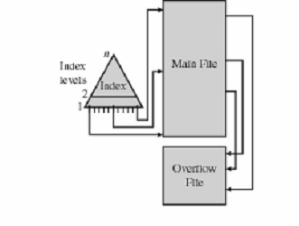
Database Management System (CS403)
VU
Indexed Sequential Summary:
Following are salient features of Indexed sequential file structure: Records are stored in sequence and index is maintained.
Dense and nondense types of indexes are maintained. Track overflows and file overflow areas are ensured. Cylinder index increases the efficiency .

